Slide 1
Legal Disclaimer:
Purchasing the Daisy Crowd Fund packages is a contribution to the equity crowd fund for the Daisy ai development and not a trading investment. Endotech is giving both shares of stock in the company and profit sharing from trading results, to each contributor as crowd funding rewards.
Prior to Endotech going public, shares of Endotech stock will be rewarded to each Crowd Fund contributor. Stock certificates will require a kyc verification of each member's legal identity before any shares of stock can be rewarded. In the case that Endotech does not go public, the equity will be converted into dividends for each member.
The trading accounts will be used for the purpose of testing and developing. Past performance does not guarantee future results, and is for informational purposes only. Historical performances shown are also the result of compounding profits. Profit rewards are contingent upon profitable trading performance and results are not a guarantee. All performance will be visible with full transparency to each crowd fund member.
Up to 46% of funds are designated in the Smart Contract for marketing via the referral rewards plan.
Daisy is not available in the US.
Disclaimer: Daisy project is not investment into trading. Daisy project was created to crowdfund Daisy AI development.

Slide 2






Decentralized AI System
SLIDE 1
Disclaimer: Daisy project is not an investment into trading. Daisy project was created to crowdfund Daisy AI development. Daisy is not available in the US.

Slide 3


WHAT IS D.AI.SY?
An Equity Crowd Funding model for financial technologies.
A decentralized smart contract, not a company.
A model where everyone can win, with profits, equity, and income.
Currently crowd funding Endotech for the Daisy AI Project.
Contributors receive exclusive stock equity and profit rewards.
Disclaimer: Daisy project is not an investment into trading. Daisy project was created to crowdfund Daisy AI development. Daisy is not available in the US.

Slide 4

WHAT IS D.AI.SY AI?
Decentralized AI System being developed by Endotech.
Daisy AI is the next generation of AI trading.
Daisy AI will significantly multiply the current AI performance.
Daisy AI is the 1st project capitalized by Daisy Crowd Fund.
Daisy AI receives $10M for Development from referral plan.
Target for live Daisy AI trading account is $500M (Daisy Fund).
Daisy AI is Endotech’s path to becoming a public company.
Disclaimer: Daisy project is not an investment into trading. Daisy project was created to crowdfund Daisy AI development. Daisy is not available in the US.

Slide 5

WHO IS ENDOTECH?
The 1st technology partner for Daisy Crowd Fund.
Global Fintech company specializing in AI trading systems.
Roadmap to complete Daisy AI and be publicly traded in 2022.
Currently providing AI trading systems for top financial institutions.
Proven track record of high-performance results.
Founded by Dr. Anna Becker, operated by top AI Scientists.
Disclaimer: Daisy project is not an investment into trading. Daisy project was created to crowdfund Daisy AI development. Daisy is not available in the US.

Slide 6

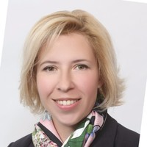
WHO IS DR.ANNA?
Her deep-learning algorithms manage over 1 Billion dollars of investment (AuM) and have been deployed in managing institutional monies for more than a decade.
Her teams of AI scientists have more than 20 proprietary AI systems in operation and serve as the AI investing backbone of trading at more than 150 investment firms across the United States, Europe and Asia.
At the age of 20 found an approximation algorithm by a factor of two, which now has wide applications in operating systems, database systems, and VLSI chip design.
Worked with CME/CBOT, FCM's and other participants of Futures and Commodities eco-system, to promote algorithmic trading platform to retail and institutional clients.
Following her PhD in Artificial Intelligence at the elite Technion University, Dr. Becker has founded and sold several AI companies in the FinTech space and is now the founder and CEO of Endotech.
Her publications have been distributed in the leading AI financial circles across Europe and America, and her Machine Learning systems have been integrated into the some of the world’s largest and most successful banks and funds worldwide including Dragon Holdings to MFGlobal.
Dr. Anna Becker Endotech CEO, FOUNDER
Disclaimer: Daisy project is not an investment into trading. Daisy project was created to crowdfund Daisy AI development. Daisy is not available in the US.

Slide 7
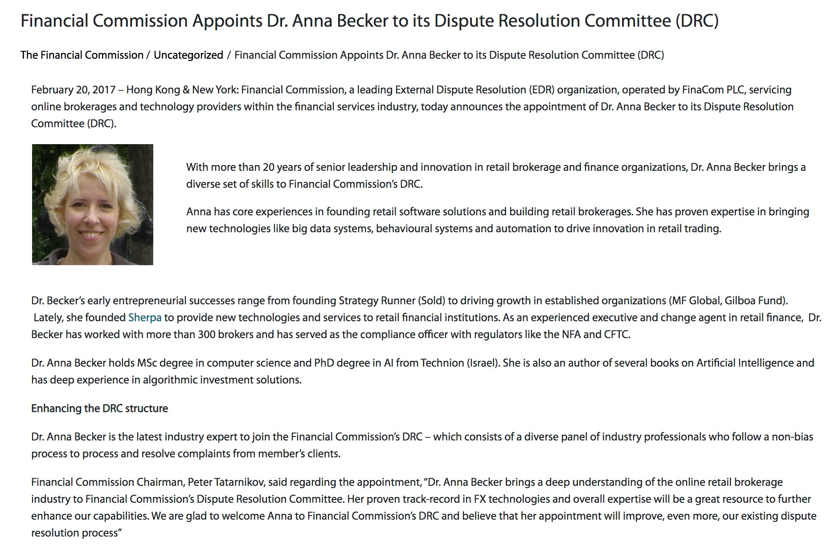
DR. ANNA BECKER APPOINTED TO DRC
Disclaimer: Daisy project is not an investment into trading. Daisy project was created to crowdfund Daisy AI development. Daisy is not available in the US.

Slide 8
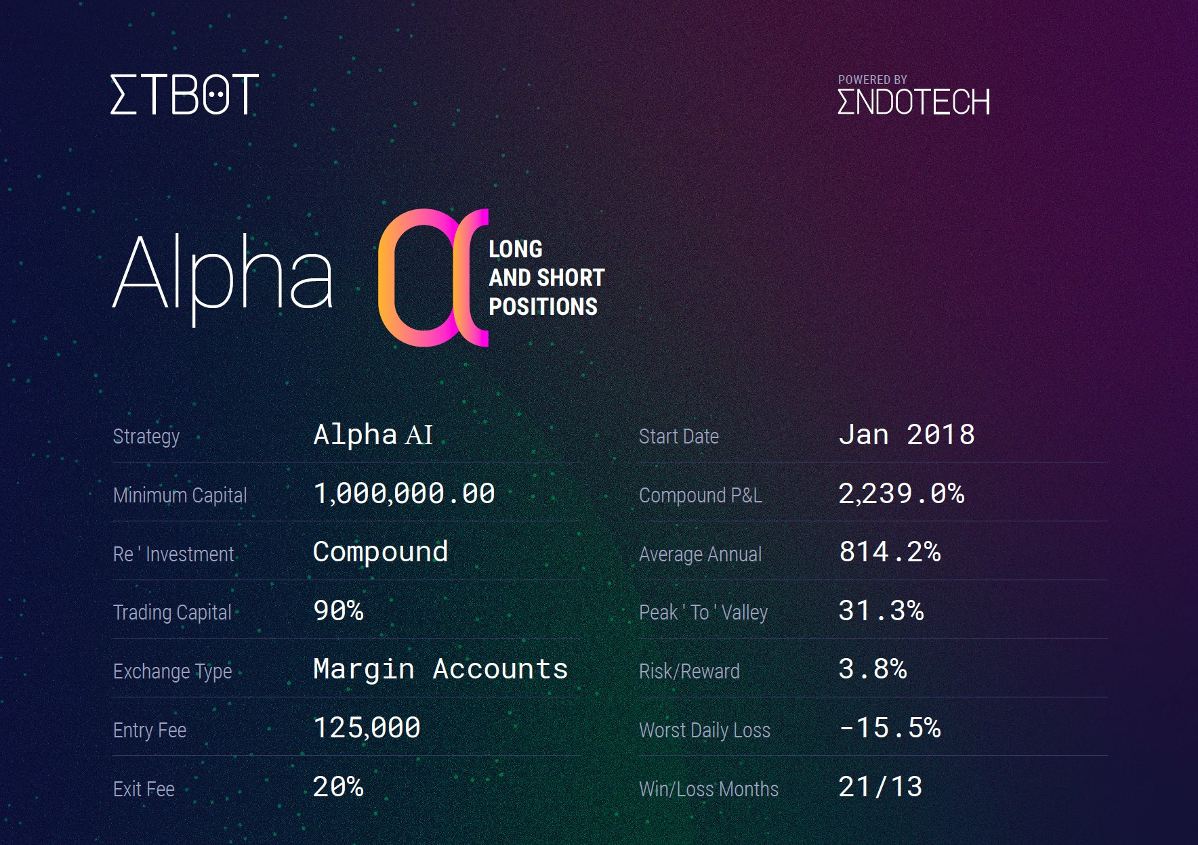
REAL AI RESULTS: TOP ALPHA STRATEGY
*Past performance is not indicative of future performance, and is for informational use only.
Disclaimer: Daisy project is not an investment into trading. Daisy project was created to crowdfund Daisy AI development. Daisy is not available in the US.

Slide 9
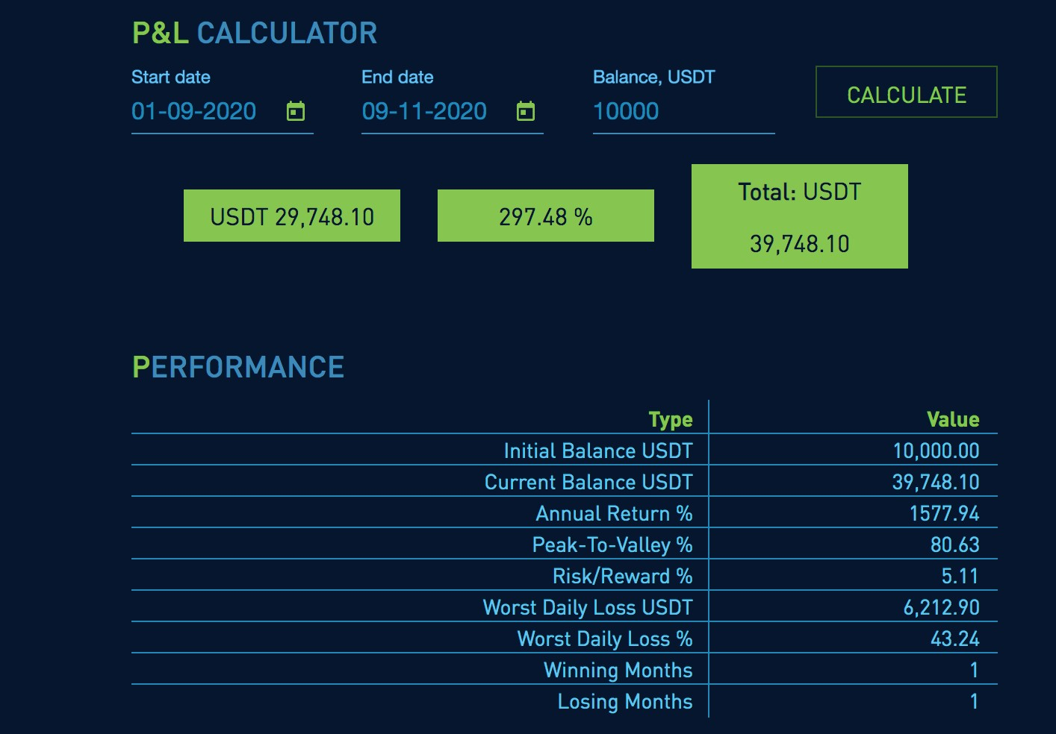
REAL AI RESULTS: TOP LEVERAGE STRATEGY
*Past performance is not indicative of future performance, and is for informational use only.
Disclaimer: Daisy project is not an investment into trading. Daisy project was created to crowdfund Daisy AI development. Daisy is not available in the US.

Slide 10
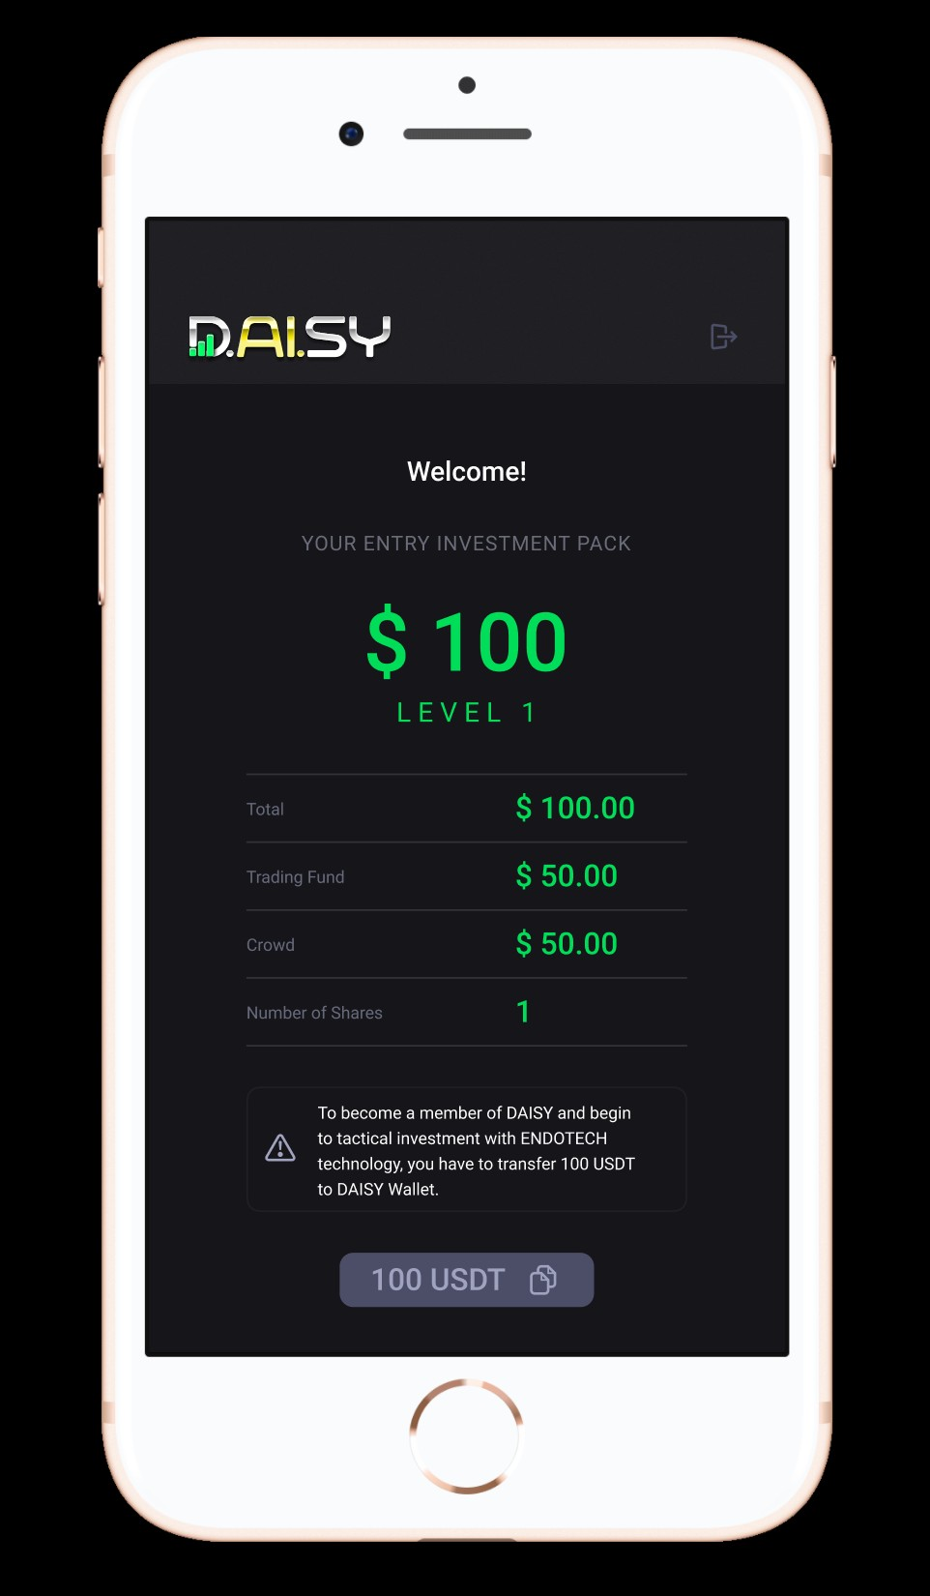
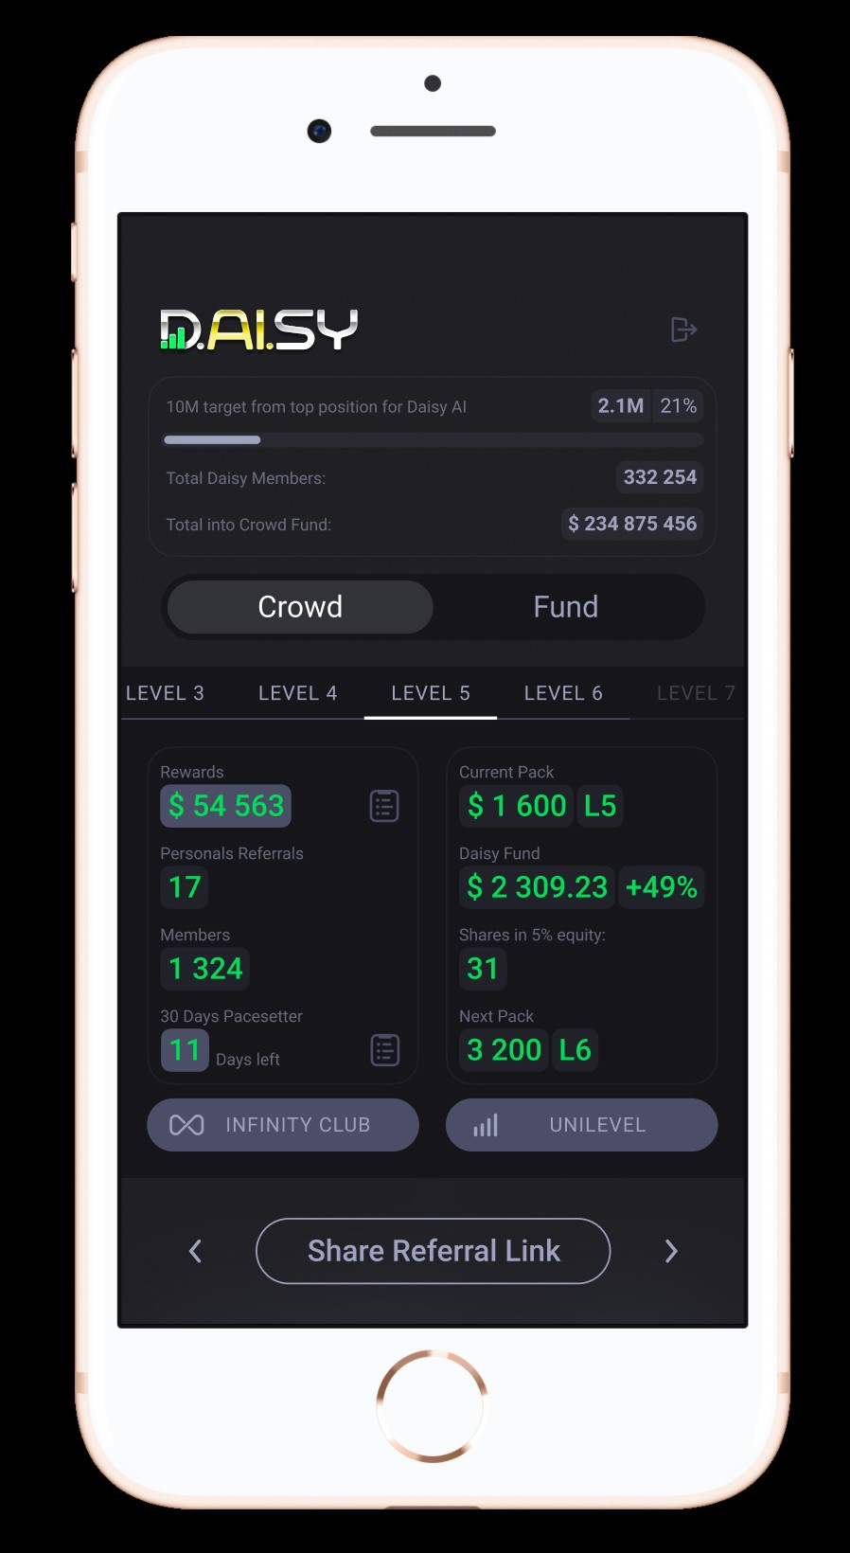
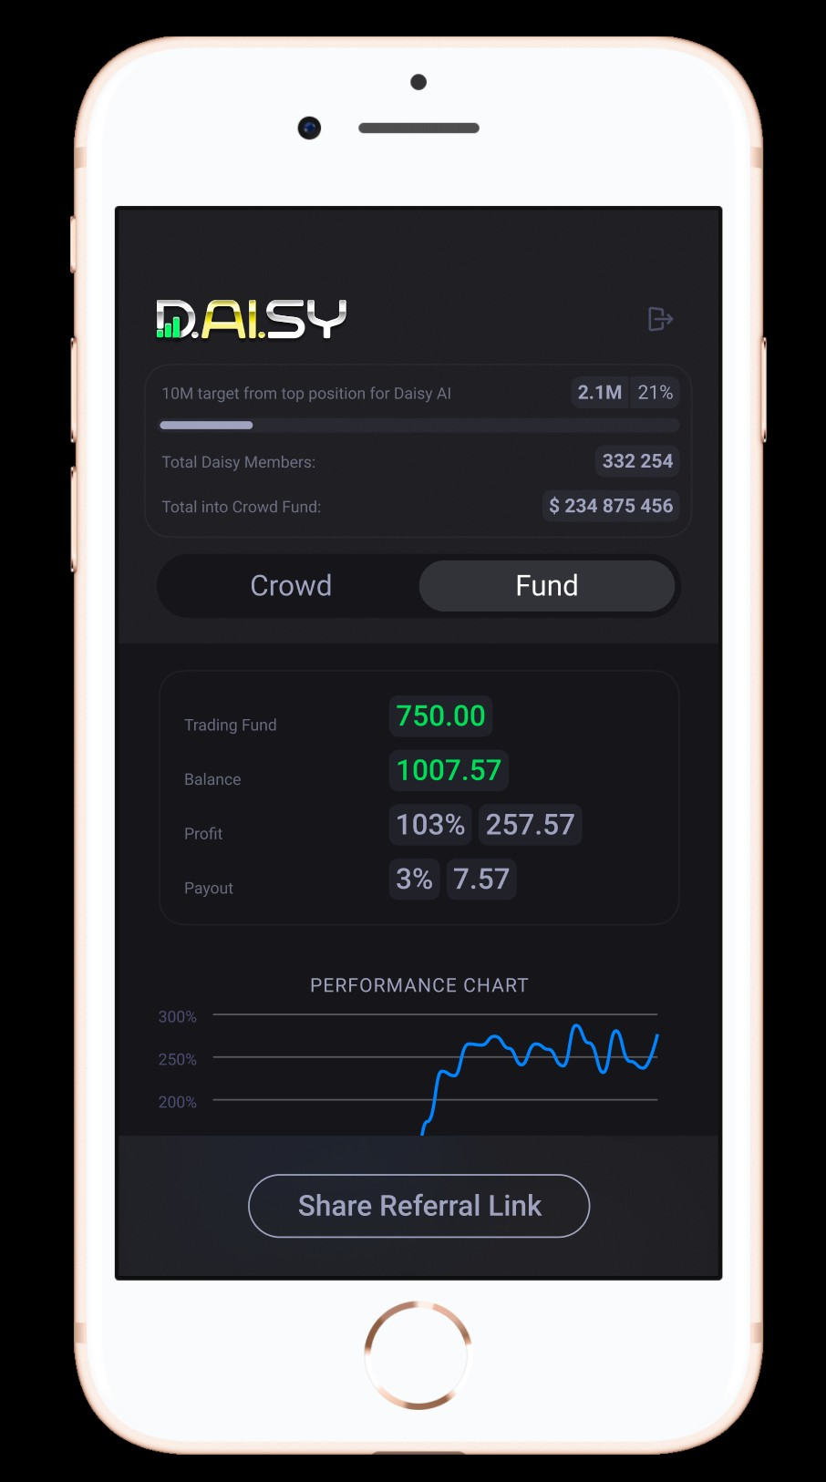

Disclaimer: Daisy project is not investment into trading. Daisy project was created to crowdfund Daisy AI development.
Disclaimer: Daisy project is not an investment into trading. Daisy project was created to crowdfund Daisy AI development. Daisy is not available in the US.

Slide 11


























2012
Registration of Endotech
2018
Commercial use of AI crypto trading started
2017
AI crypto trading developed and implemented
November 2020
Endotech valuation $100M
2021
Crowdfunding $10M into Daisy AI
Phase 1 Development of Daisy AI
$500 million of AUM in Daisy Fund
December 2020
Launch of Daisy Crowd
2022
Complete Daisy AI
Endotech goes public
2022
Adding Forex AI trading to Daisy
Additional $1 Billion of AUM
2023
Adding stock AI trading to Daisy Fund
11

Slide 12

REWARDS FOR CONTRIBUTORS
Up to 10 Crowd Funding Tiers to choose from starting at just $100.
Every contributor gets their equal share of 5% Endotech stock.
50% to 70% of each contribution is used in trading for development.
70% of the trading profits are rewarded back to the contributor.
15% of the trading profit are rewarded to the residual referral plan.
Contributors can withdraw trading rewards at anytime.
All members are able to participate in the Daisy referral plan.
Referral plan pays out up to 46% of each contribution.
Disclaimer: Daisy project is not an investment into trading. Daisy project was created to crowdfund Daisy AI development. Daisy is not available in the US.

Slide 13



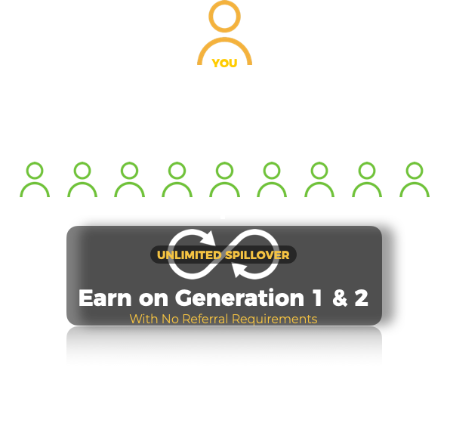

SMART CONTRACT DISTRIBUTION OF FUNDS
Wallet
85% Profit Rewards
Up to 46% Payout
Contribution
50% to 70% into live trading
Up to 46% into Referral Plan
Fund
Crowd
Disclaimer: Daisy project is not an investment into trading. Daisy project was created to crowdfund Daisy AI development. Daisy is not available in the US.

Slide 14

WHY TRON BLOCKCHAIN
Allows automated interaction between members and Daisy
Removes the need for a company to be in control
Allows all promises to be executed instantly with 100% transparency
Tron blockchain is among the fastest and most scalable
Low gas fees allow for high performing smart contracts at low cost
Tron is a top emerging Decentralized App platform with a big future
Tron tokens (trx) are expected to rise in value
Disclaimer: Daisy project is not an investment into trading. Daisy project was created to crowdfund Daisy AI development. Daisy is not available in the US.

Slide 15

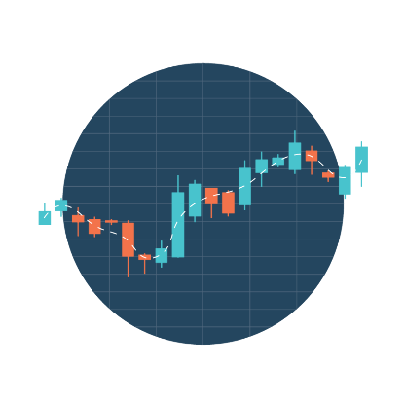

PASSIVE INCOME
Benefits even if a member does not refer anyone.
1. Owning equity - potential return from selling Endotech stock or receiving dividends in the future
2. Trading rewards - potential rewards from successful trading performance of Endotech’s AI System
3. Potential matrix spillover, generating maximum of 48% return on crowdfunding contribution from spillover in the referral plan, even with no referrals.
GENERATION
PERSONALS
REQ. TOTAL
MEMBERS
Tiers 1-7
Tiers 8-10
$100 Tier 1
Tiers 1-7
Tiers 8-10
1 | 0 | 0 | 3 | 4% | 2% | $12 | $1,524 | $5,376
2 | 0 | 0 | 9 | 4% | 2% | $36 | $4,572 | $16,128
Disclaimer: Daisy project is not an investment into trading. Daisy project was created to crowdfund Daisy AI development. Daisy is not available in the US.

Slide 16

CROWD FUND TIER TABLE
10 Crowd Fund Tiers
Total Funded
Trade Account
Daisy Crowd
Shares in 5% Equity
Entry 1: $100 | $100 | $50 | $50 | 1
Entry 2: $200 | $300 | $150 | $150 | 3
Entry 3: $400 | $700 | $350 | $350 | 7
Entry 4: $800 | $1,500 | $750 | $750 | 15
Entry 5: $1,600 | $3,100 | $1,550 | $1,550 | 31
Entry 6: $3,200 | $6,300 | $3,150 | $3,150 | 63
Entry 7: $6,400 | $12,700 | $6,350 | $6,350 | 127
Entry 8: $12,800 | $25,500 | $15,310 | $10,190 | 255
Entry 9: $25,600 | $51,100 | $33,230 | $17,870 | 511
Entry 10: $51,200 | $102,300 | $69,070 | $33,230 | 1,023
50/50
70/30
Disclaimer: Daisy project is not an investment into trading. Daisy project was created to crowdfund Daisy AI development. Daisy is not available in the US.

Slide 17

Disclaimer: Daisy project is not an investment into trading. Daisy project was created to crowdfund Daisy AI development. Daisy is not available in the US.

Slide 18

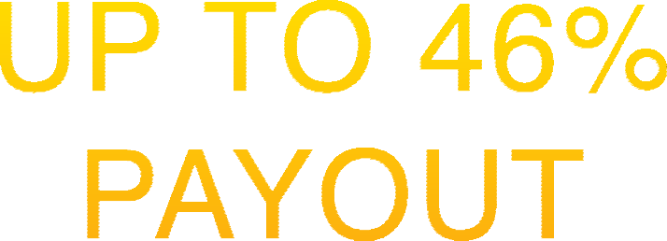
REFERRAL PLAN
Personal Referral Bonus
3x10 Forced Matrix Bonus
Matrix Check Matching Bonus
Pacesetter Gold Bonus
Pacesetter Leadership Bonus
10 Generation Unilevel Trading Bonus
Pacesetter Gold Bonus
Pacesetter Leadership Bonus
Pace-Setters Equity Bonus
Disclaimer: Daisy project is not an investment into trading. Daisy project was created to crowdfund Daisy AI development. Daisy is not available in the US.

Slide 19


PERSONAL REFERRAL BONUS
5%
DIRECT BONUS from PERSONAL REFERRALS
NO QUALIFICATIONS REQUIRED
19
Disclaimer: Daisy project is not an investment into trading. Daisy project was created to crowdfund Daisy AI development. Daisy is not available in the US.

Slide 20


FORCED MATRIX PLACEMENT
CASE 1
(WITHOUT SPILLOVER)
CASE 2
(WITH SPILLOVER)
1
2
3
4
10
5
11
6
12
7
8
9
Disclaimer: Daisy project is not an investment into trading. Daisy project was created to crowdfund Daisy AI development. Daisy is not available in the US.

Slide 21






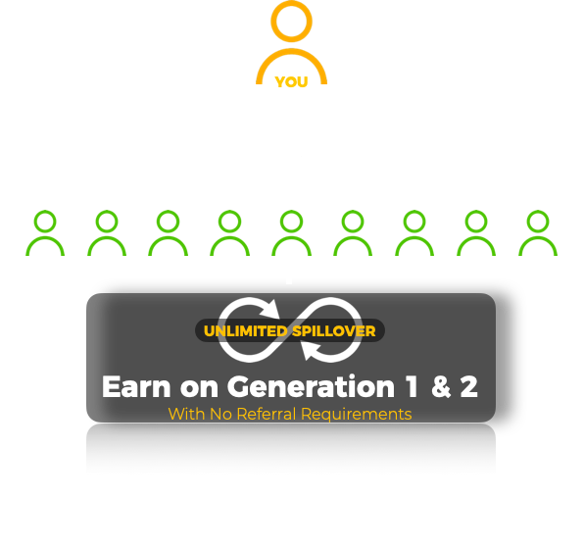





CONTRIBUTION TIERS
UPGRADE TO EARN MORE
$100 Funding Tier
MATRIX GEN | $100 MEMBERS
1 | 3
2 | 9
3 | 27
4 | 81
5 | 243
6 | 729
7 | 2187
8 | 6561
9 | 19683
10 | 59683
TOTAL | 88,572
Each contribution tier that you fund lets you earn when those same tiers are funded within your Matrix.
$200 Packs Compress up to $200 Pack Members
LOCKED
$400 Packs Compress up to $400 Pack Members
LOCKED
100$
Purchased
Your Funding Tier determines the tiers you earn from in the Matrix.
Purchase Pack to Unlock This Matrix
$200 Upgrade
Purchase Pack to Unlock This Matrix
$400 Upgrade
Higher contribution tiers funded in your Matrix will compress up to the next qualified member.
P U R C H A S E
P U R C H A S E
Disclaimer: Daisy project is not an investment into trading. Daisy project was created to crowdfund Daisy AI development. Daisy is not available in the US.

Slide 22
MATRIX BONUS
GENERATION
PERSONALS
FUNDED BY REFERRALS
MEMBERS
Tiers 1-7
Tiers 8-10
If $100 Tier 1
If Tiers 1-7
If Tiers 8-10
1 | 0 | 0 | 3 | 4% | 2% | $12 | $1,524 | $5,376
2 | 0 | 0 | 9 | 4% | 2% | $36 | $4,572 | $16,128
3 | 3 | 1000 | 27 | 3% | 1.5% | $81 | $10,287 | $36,288
4 | 6 | 2000 | 81 | 3% | 1.5% | $243 | $30,861 | $108,864
5 | 9 | 4000 | 243 | 3% | 1.5% | $729 | $92,583 | $326,592
6 | 12 | 8000 | 729 | 3% | 1.5% | $2,187 | $277,749 | $979,776
7 | 15 | 16000 | 2187 | 3% | 1.5% | $6,561 | $833,247 | $2,939,328
8 | 18 | 32000 | 6561 | 3% | 1.5% | $19,683 | $2,499,741 | $8,817,984
9 | 21 | 64000 | 19683 | 4% | 2% | $78,732 | $9,998,964 | $35,271,936
10 | 24 | 128000 | 59,049 | 4% | 2% | $236,196 | $29,996,892 | $105,815,808
TOTAL | 24 | 128,000 | 88,572 | 34% | 17% | $344,460 | $43,746,420 | $154,318,080
*MATRIX IS LOCKED AT 10 GENERATIONS. EARN FROM ALL MEMBER TIERS BOUGHT ON ANY QUALIFIED GENERATION. UNQUALIFIED BONUSES DO NOT HOLD OR COMPRESS, HOWEVER HIGHER TIERS FULLY COMPRESS WHEN PURCHASED.
TOTAL = $198,408,960
Disclaimer: Daisy project is not an investment into trading. Daisy project was created to crowdfund Daisy AI development. Daisy is not available in the US.

Slide 23
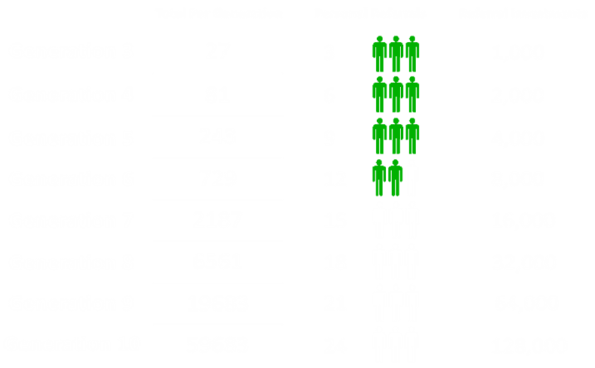
MATRIX CHECK MATCHING BONUS
10%
FROM MATRIX BONUS
OF DIRECTLY SPONSORED MEMBERS
Example:
Earn 10% from matrix bonus of personally sponsored members generated from 5 generations
If you are at the $100 contribution tier, you earn match from the $100 Matrix
Qualification: your matrix bonus qualification level determines how many levels of matrix bonus from your personals you will match.
You can only match matrix checks from contribution tiers not higher than yours.
23
Disclaimer: Daisy project is not an investment into trading. Daisy project was created to crowdfund Daisy AI development. Daisy is not available in the US.

Slide 24

UNILEVEL RESIDUAL TRADING BONUS
LEVEL
Trading Override
Residual Income pays out when any member withdraws their trading rewards
1 | 3.5%
2 | 1%
3 | 1%
4 | 1%
5 | 1%
6 | 1%
7 | 1%
8 | 1%
9 | 1%
10 | 1%
•
Pays on trading rewards from all members on each level
Automatically earn from the trading rewards on Level 1 & 2
•
Levels 3-10 follow Matrix rules to qualify for Levels
•
Full dynamic compression pays up to qualified members
•
No limit on residual income
Disclaimer: Daisy project is not an investment into trading. Daisy project was created to crowdfund Daisy AI development. Daisy is not available in the US.

Slide 25

PACE SETTER GOLD BONUS
MATRIX
GENERATION
REFERRAL REQUIREMENT
TOTAL FUNDED BY
REFERRALS
TOTAL DAISY MEMBERS
UNLOCK ANY MATRIX LEVELS 3-9
IN YOUR 1ST 30 DAYS, GET THE NEXT MATRIX LEVEL UNLOCKED FOR LIFE!
1 | 0 |  | 3
2 | 0 |  | 9
3 | 3 | 1000 | 27
4 | 6 | 2000 | 81
5 | 9 | 4000 | 243
6 | 12 | 8000 | 729
7 | 15 | 16000 | 2187
8 | 18 | 32000 | 6561
9 | 21 | 64000 | 19683
10 | 24 | 128000 | 59049
TOTAL | 24 | 128,000 | 88572
UNLOCK LEVEL 10 IN YOUR 1ST 30 DAYS
GET PROFIT SHARING IN
1.8% OF ALL GLOBAL CONTRIBUTIONS
1.25% OF ALL GLOBAL TRADING PROFITS
5% EQUITY SHARE OF ENDOTECH STOCK
Disclaimer: Daisy project is not an investment into trading. Daisy project was created to crowdfund Daisy AI development. Daisy is not available in the US.

Slide 26
PACE SETTER LEADERSHIP BONUS
YOU
Your 3 DIRECT RECRUITS
1
2
3
PACE SETTER
GOLD QUALIFED
PACE SETTER
GOLD QUALIFED
PACE SETTER
GOLD QUALIFED
HELP YOUR 3 X DIRECTS BECOME PACE SETTER GOLD QUALIFED.
EVERY 3 NEW DIRECTS = 1 NEW SHARE in this profit sharing
GET ‘ADDITIONAL’ PROFIT SHARING IN
1.8% OF ALL GLOBAL CROWD FUNDING
1.25% OF ALL GLOBAL TRADING PROFITS
5% EQUITY SHARE OF ENDOTECH STOCK
Disclaimer: Daisy project is not an investment into trading. Daisy project was created to crowdfund Daisy AI development. Daisy is not available in the US.

Slide 27
PACE SETTER GOLD & LEADERSHIP BONUS
YOU
YOU
Your 3 DIRECT
RECRUITS
MATRIX
GENERATION
REFERRAL REQUIREMENT
TOTAL FUNDED BY
REFERRALS
10 | 24 directs | $128,000
1
2
3
PACE SETTER
GOLD QUALIFED
PACE SETTER
GOLD QUALIFED
PACE SETTER
GOLD QUALIFED
UNLOCK LEVEL 10 IN YOUR 1ST 30 DAYS
GET PROFIT SHARING IN
1.8% OF ALL GLOBAL CONTRIBUTIONS
1.25% OF ALL GLOBAL TRADING PROFITS
5% EQUITY SHARE OF ENDOTECH STOCK
HELP YOUR 3 DIRECTS = 1 SHARE
GET ‘ADDITIONAL’ PROFIT SHARING IN
1.8% OF ALL GLOBAL CROWD FUNDING
1.25% OF ALL GLOBAL TRADING PROFITS
5% EQUITY SHARE OF ENDOTECH STOCK
*1st 30 days from your registration
*No time limit to qualify
Disclaimer: Daisy project is not an investment into trading. Daisy project was created to crowdfund Daisy AI development. Daisy is not available in the US.

Slide 28

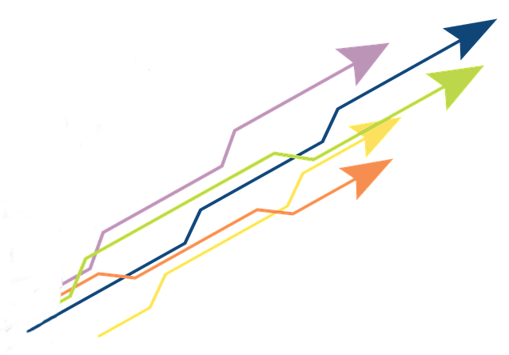
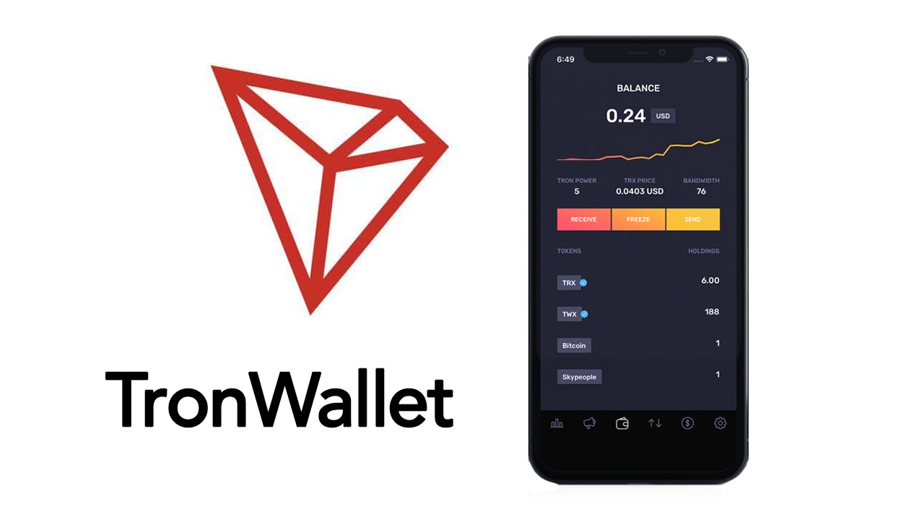
TWO PACE SETTER BONUSES
Potentially up to 3.6% from EVERY CONTRIBUTION WORLDWIDE
Potentially up to 2.5% from EVERY TRADING PROFITS WORLDWIDE
is divided between all qualified Pacesetters, and pays out INSTANTLY!
WALLET
Imagine thousands of deposits every day directly into your wallet!
Earn from every single contribution made by every single member around the world, INSTANTLY!
Disclaimer: Daisy project is not an investment into trading. Daisy project was created to crowdfund Daisy AI development. Daisy is not available in the US.

Slide 29

3 CATEGORIES OF MEMBERS
Tiers 1-7 | 50% goes to Daisy Fund
Tiers 8-10 | 70% goes to Daisy Fund
VIP customers | Coming soon: 100% goes to Personal Account
Disclaimer: Daisy project is not an investment into trading. Daisy project was created to crowdfund Daisy AI development. Daisy is not available in the US.

Slide 30
VIP CUSTOMERS (COMING SOON)
GENERATION | Trading Bonus
1 | 1%
2 | 1%
3 | 1%
4 | 1%
5 | 1%
6 | 1%
7 | 1%
8 | 1%
9 | 1%
10 | 1%
Become a VIP customer:
Begins after entry levels 1-10 are purchased
100% of your funds goes into trading
Minimum $20,000 USD
Funds stay in your personal wallet
5% Setup Fee to Endotech (promotion)
You keep 80% of profits
10% goes in referral rewards plan
Disclaimer: Daisy project is not an investment into trading. Daisy project was created to crowdfund Daisy AI development. Daisy is not available in the US.

Slide 31

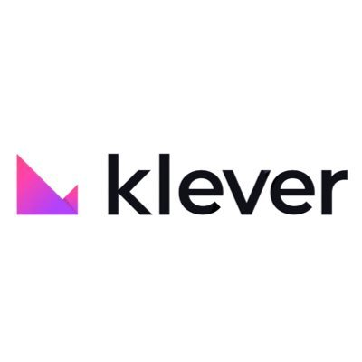
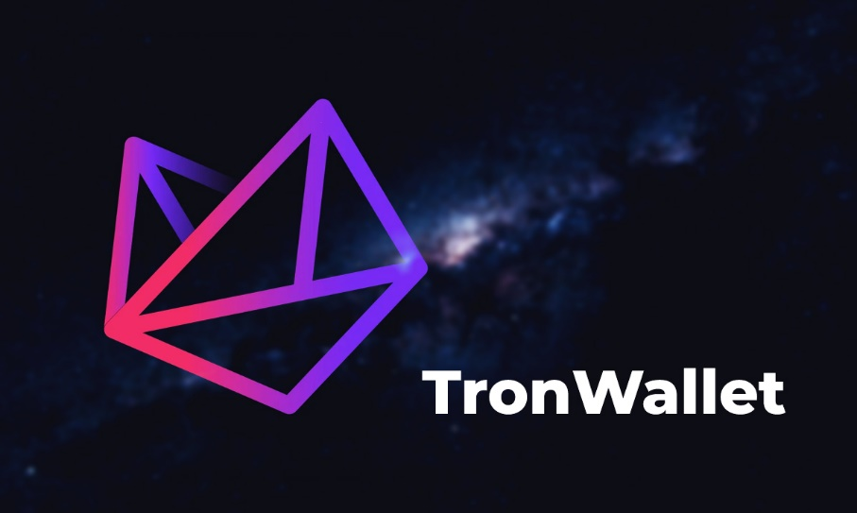
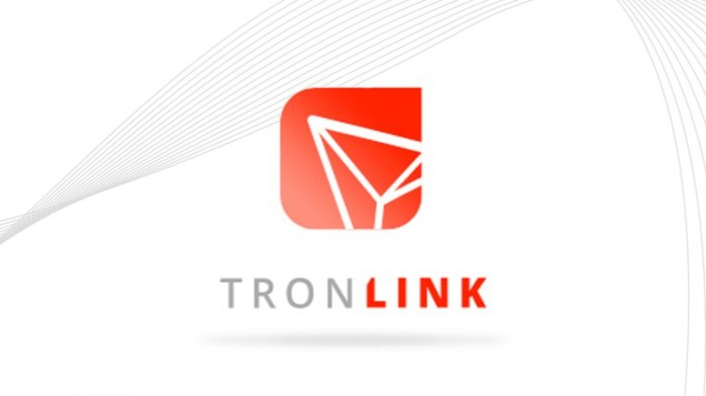
HOW TO JOIN DAISY
Download an approved Tron Wallet app
Prepare TRX equivalent of minimum $100
Get a sign up link from your referrer
Purchase minimum of Entry Level 1 and secure your spot in the matrix
Disclaimer: Daisy project is not an investment into trading. Daisy project was created to crowdfund Daisy AI development. Daisy is not available in the US.

Slide 32
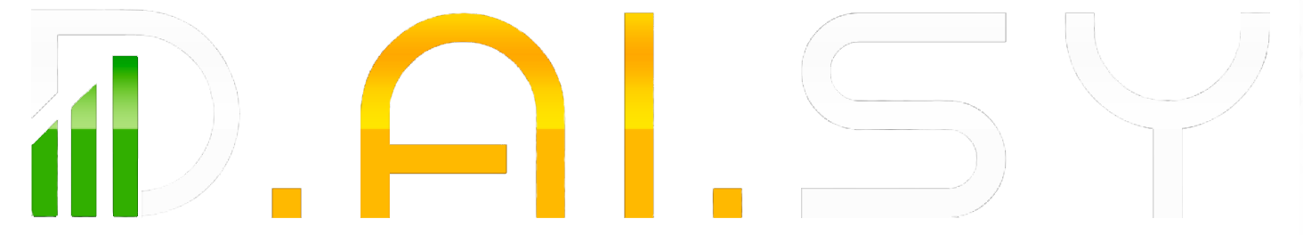
TOGETHER WE CREATE HISTORY

